Slide 1
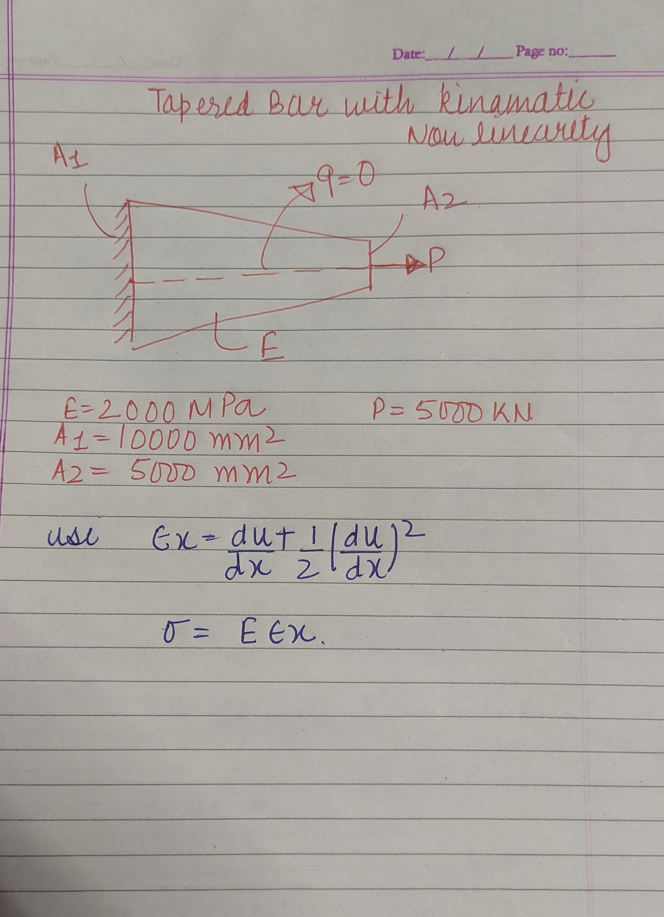
1-D Tapered bar with kinematic nonlinearity
2 Node 10 elements have been considered for the problem.
The Algorithm used is given in the next slide followed by outputs that include nodal displacements ,stress-strain curve and strain-displacement curve
Newton Raphson method has been used to solve linearized system of equation incrementally.

Slide 2
Algorithm
5.Get Global Kt,and Forces
6.Initialize u
7.Newton Raphson loop starts
Set iter=1
Solve linearized system to get increments(∆u)
Update u=u+∆u
Check convergence
If convergence< tolerance
Stop
Else go to step6
1.Governing Equations weak form and linearization
1.Define Geometry: Mesh information, coordinates, area, elements etc.
2.Define material: Youngs modulus.
3.Shape functions and their derivatives calculations
4.Elemental loop starts
Get elemental Kt
Get elemental internal force
Get elemental external force
Elemental loop ends.

Slide 3
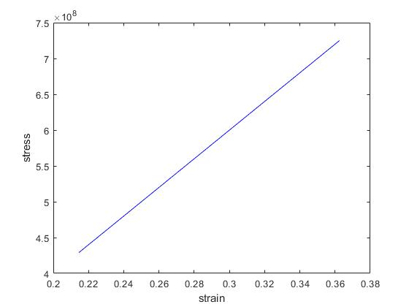
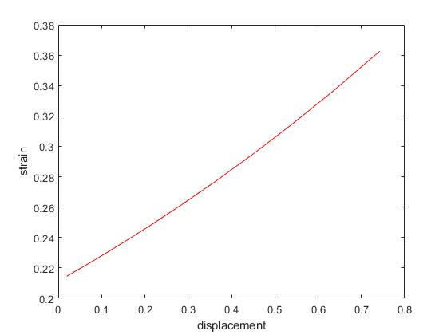
Node | 11 | 22 | 33 | 4 | 5 | 6 | 7 | 8 | 9 | 10 | 11
displacement (m) | 0 | 0.019540 | 0.039917 | 0.061207 | 0.083500 | 0.10690 | 0.13154 | 0.15755 | 0.18511 | 0.21443 | 0.24577

